Slide 1
Lecture 25
Magneto-Optics and Optical Activity

Slide 2
Time reciprocity
This arrangement does stop the light reflected from the mirror from coming back
But it does not stop the light originating on the right from going left
The reason is time reciprocity of linear, non-magnetic and lossless optics
We have a set two second order differential equations:
If we reverse the sign of time both equations will stay unchanged – hence the time reciprocity if only electric forces are considered

Slide 3
Nonreciprocity with Magnetic field
What if we have DC magnetic field?
If we reverse direction
Lorentz Force
v₄
+V
v₁
E
v₁
v₃
-v₄
v₁
v₁
v₁
v₂
B
-v₃
v₁
-v₂
v₁
-v₂
-V
v₁
End up where we have started from
If we reverse direction
We do not get back – no time reciprocity because the first derivative changes sign

Slide 4
Motion In The Presence Of DC Magnetic Field
y
-
Consider isotropic medium
+
E₀
B
e-cloud
E_{y}
K_{x}
x
E_{x}
K_{y}
k
z
DC Magnetic field will try to impose counter-clock-wise circular motion onto the electron therefore we consider circularly polarized light
Equation of motion:
Introduce the Larmore frequency

Slide 5
Motion In The Presence Of Magnetic Field
K
Equation of motion:
B
K
Two projections
+
×j
Introduce
Looking for harmonic solution

Slide 6
Susceptibility In The Presence Of Magnetic Field
B
K
K
Projections:
Circular polarization
Different susceptibilities for different helicities

Slide 7
Dielectric constant In The Presence Of Magnetic Field
B
Dispersion curves shift left or right by Larmore frequency
Dielectric constant
0.85
0.9
0.95
1
1.05
1.1
Frequency ω/ω0

Slide 8
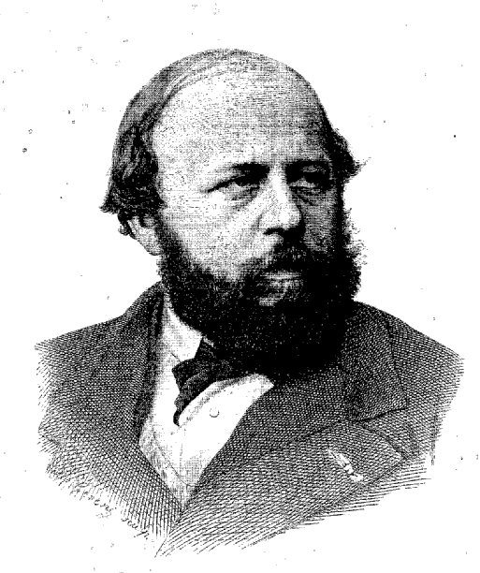
Verdet constant
Faraday's cell
L
B
Phase shift between two circular polarizations
Verdet constant
Order of magnitude
V~10 rad/T.m
Émile Verdet
1824-1866

Slide 9
Verdet constant of different materials
Material λ(nm) V (rad T⁻¹)
Water 589.3 3.81
Diamond 589.3 4.68
Quartz 589.3 4.84
Light flint glass 589.3 9.23
CS₂ 589.3 12.3
Pr³⁺ -B glass 670 -70.7
Pr³⁺ -Al- Si glass 700 -57.6
Tb³⁺ - Al- Si glass 700 -62.8
Dy³⁺- Al-Si glass 700 -79.1
Pr³⁺ - P glass 700 -35.8
Tb³⁺ - P glass 700 -43.6
Ce³⁺ -P glass 500 -94.7
700 -38.4
Pure silica glass 532 4.77
632.8 3.13
785 2.58
Tb₃Ga₅O₁₂ 500 -218
632.8 - 134
800 -65
1300 - -20
Verdet constant is positive for diamagnetic materials and negative for paramagnetic materials

Slide 10
Jones Matrix of Faraday’s cell
Introduce the vector in which polarization state is a superposition of right and left circular polarizations
In this basis the Faraday's cell is nothing but a retardation plate
In the xy basis then
Linearly polarized light rotates by the angle
E
Specific rotation
y
y
E₊
E₋
E
E₊
x
x
E₋
z
k

Slide 11
Polarization rotation in permanent magnets
Quite often one uses permanent magnets made from a ferromagnetic or ferromagnetic material with internal magnetization M Then polarization rotation is
Saturation magnetization
YIG –Y₃Fe₅O₁₂

Slide 12
Dielectric constant
What happens with a tensor of dielectric constant?
Therefore, tensor of dielectric constant is
Polarization
Meaning of δ –
rotation over the length L=nλ/π
Substitute into the wave equation for the circularly polarized light
As expected

Slide 13
Sanity check
What about the energy? Imaginary permittivity implies loss, does not it?
Displacement vector is
Displacement current is
is out of phase with E –no power dissipation
Power dissipation
The energy does not change as it should be – DC magnetic field does not change energy
So, off diagonal elements can have imaginary part and it does not mean loss
(as long as the matrix is Hermitian, i.e. )

Slide 14
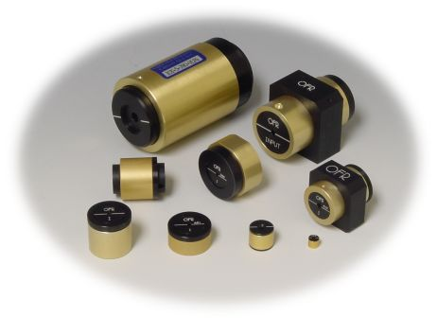
Optical isolator
No light goes through!
In
Both x and B get reversed
E
E
B
L
B
L
E
E
45°
E
y
In
Out
y
B
×
B
Light goes through
x
x

Slide 15
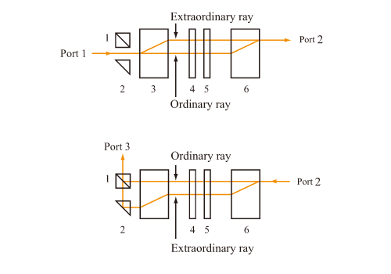
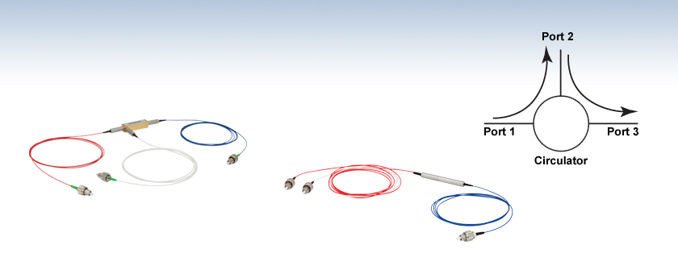
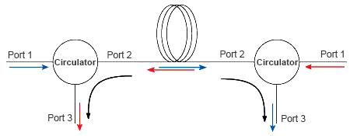
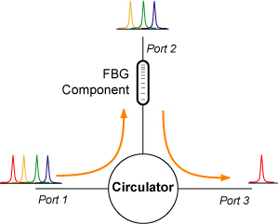
Optical circulator
R₄₅
R₄₅
R₄₅
R₋₄₅
Configuration of optical circulator. 1: Polarization beam splitter (PBS), 2: reflection prism, 3 and 6: Birefringence crystal, 4: Faraday rotator, 5: half-wave plate
Bidirectional transmission over a single fiber
Filtering with Fiber Bragg grating

Slide 16
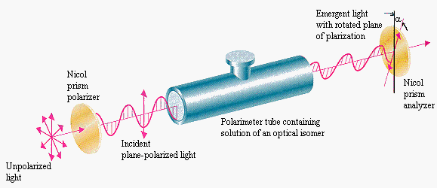
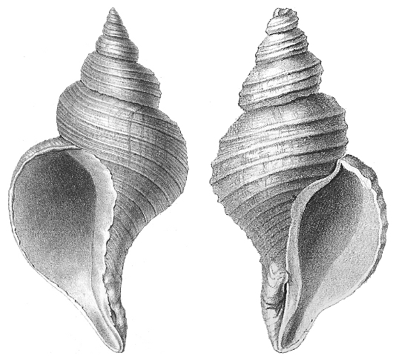

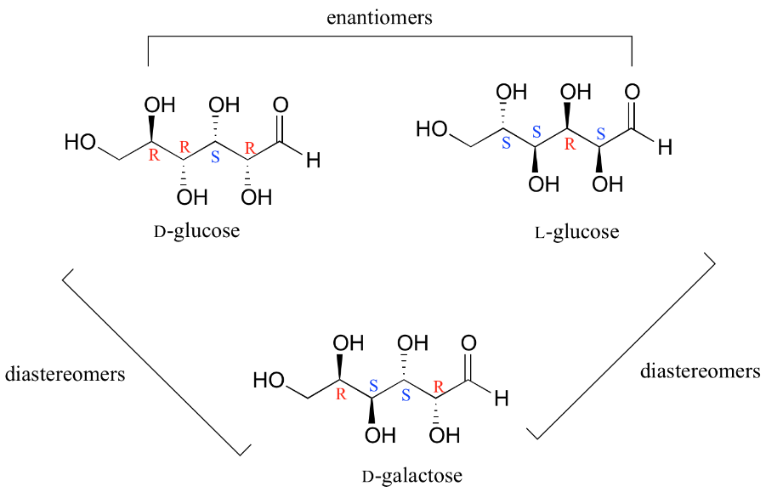
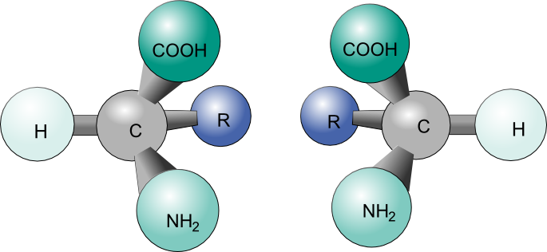
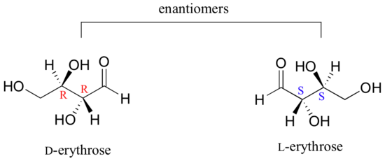
Optical Activity
Optical activity is phenomenon of circular birefringence that occurs in certain materials, called chiral that occurs without any external field. In chemistry, a molecule or ion is called chiral if it cannot be superposed on its mirror image by any combination of rotations and translations.
Shells of two different species of sea snail: on the left is the normally sinistral (left-handed) shell of Neptunea angulata, on the right is the normally dextral (right-handed) shell of Neptunea despecta
Two enantiomers of a tetrahedral complex.

Slide 17
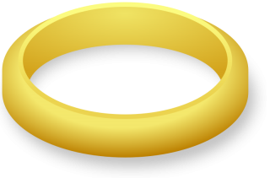
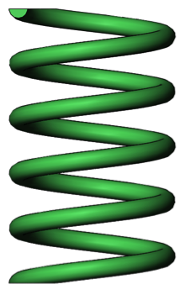
Origin of optical activity
H,B
H,B
y
y
“chiral molecule”
“molecule”
-
+
-
+
+
-
J
E
J
E
E
x
x
z
z
Dipole along x direction
Helical current – charges move along y as well
According to Lenz rule
Response of chiral entity

Slide 18
Optical activity
Response of a chiral entity
But
90 degrees rotation
Gyration vector
(dimensionless)
Consider wave propagating along z direction, then
Gyration tensor
Sign changes with direction of propagation – indicates reciprocity
Compare with Faraday effect
Sign does not depend on direction of propagation-only on the direction of magnetic field –no reciprocity

Slide 19
Polarization rotation
Just as for Faraday effect
Phase shift between two circular polarizations
Rotation angle
Rotation is reversed for backward propagation – no isolation!
Optical rotary power
Very strong dispersion

Slide 20
Optically active crystals

